Slide 1
Introductory General Chemistry
Chemistry 3A
S. M. Halloran

Slide 2
Concepts
Scientific Method
Atomic Theory
Subatomic Structure: protons, electrons, neutrons
Atomic Properties
Patterns of matter: Periodic Table
Electric properties of atoms: ions
Neutrons and isotopes
Atomic mass: weight average of atoms

Slide 3
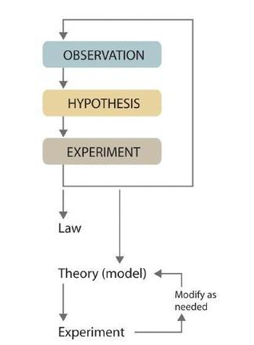
Scientific Method
Terms You Should Know
Observation
Hypothesis
Experiment
Theory (or model)
Law

Slide 4
Scientific Method
Observations
Qualitative
properties or occurrences in ways that do not rely on numbers
table salt is crystalline solid
dilute nitric acid used to dissolve penny forms blue solution and brown gas
air temperature is cooler in winter season
Quantitative
numerical measurements (data has number with units!)
melting point of crystalline sulfur → 115.21°C
35.9 g sodium chloride (NaCl) will dissolve in 100 g water at 20 °C
Iridium in sediments from 66 million years ago were 20-160 times higher than normal

Slide 5
Scientific Method
Hypothesis
A tentative explanation to account for (set of related) observations
Two hypotheses to account why sun rises in east and sets in the west
Sun revolves around the Earth geocentric hypothesis for observation
Earth rotates on an axis, exposing only one side to sun heliocentric hypothesis for observation
Iridium levels observation brought hypothesis that dinosaur extinction event by large extraterrestrial object hitting Earth

Slide 6
Scientific Method
Experiment
Systematic observations or measurements, preferably made under controlled conditions—that is, under conditions in which a single variable changes
These are designed to test validity of a hypothesis (more experiments test additional hypotheses)
Experimental results should show if hypothesis is correct or sound or needing to be modified or revised
A wrong hypothesis does not mean there are problems with scientific method or with “doing science”. It means an educated guess was made, was not true in whole or in part, and a new guess is needed

Slide 7
Scientific Method
n = 3, not n = 1
Experimental results should be reproducible, that is repeated experiments
n refers to the number of times an experiment under identical conditions is to be done to get results which should be reproduced to prove the reliability, dependability, precision, accuracy of observations
It is generally accepted an experiment should be done 3 times (n = 3) to show results are reproducible. It is never acceptable to do an experiment only once (n = 1)

Slide 8
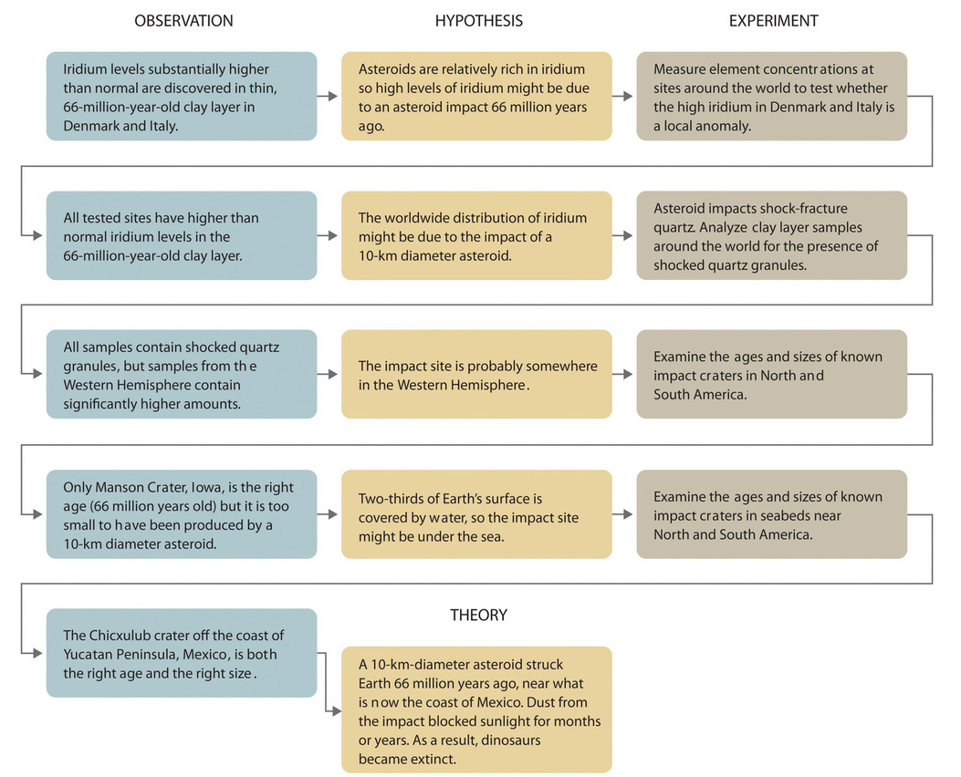
Scientific Method
Asteroid Theory and Dinosaur Extinction
Development of a Theory
Observation → Hypothesis → Experiment
repeated cycles

Slide 9
Atomic Theory
A couple of millennia* ago, Greek philosophers talked about matter as made of atoms
Tiny, indivisible, solid objects
But it was only a couple of centuries ago (1800s) that experimental science really propelled humanity forward
English chemist John Dalton (researcher, professor)
Studied combustion: carbon reacting with oxygen
Elements were already known for millennia
Knew water had elements hydrogen and oxygen
Proposed a theory based on experimental results that “the known elements are actually composed of atoms”
*Science is also about history, a history showing learning through trial-and-error & progression of thought and knowledge

Slide 10
Dalton’s Atomic Theory
All matter made of indivisible atoms
Atoms are smallest units of matter
Atoms cannot be created, divided, or destroyed (later revised with the discovery of subatomic particles)
All atoms of a given element are identical
Atoms of the same element have same mass and properties
later revised—atoms of the same element can have different masses known as isotopes
Compounds are formed by a combination of atoms of different elements
A given compound always contains the same kinds and ratios of atoms
Chemical reactions involve the rearrangement of atoms
Atoms are neither created nor destroyed in a chemical reaction—only rearranged
Atoms are about 5.4 x 10⁻¹⁰ m in diameter
= 0.54 nanometer (nm) or 5.4 angstrom (Å)

Slide 11
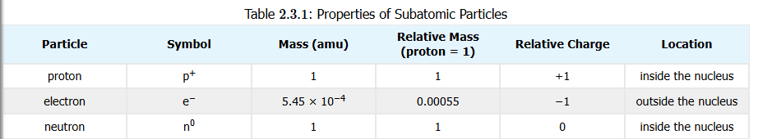
Subatomic Structure
Chemists see the atom structure having the important properties of mass and (electric) charge
Electrons
mass = 9.109 x 10⁻³¹ kg, 5.486 x 10⁻⁴ amu
charge = -1
Protons
mass = 1.673 x 10⁻²⁷ kg, 1.007 amu, 1836 times electron mass
charge = +1
Neutrons
mass = 1.675 x 10⁻²⁷ kg, 1.009 amu, 1.001 times proton mass
charge = 0

Slide 12
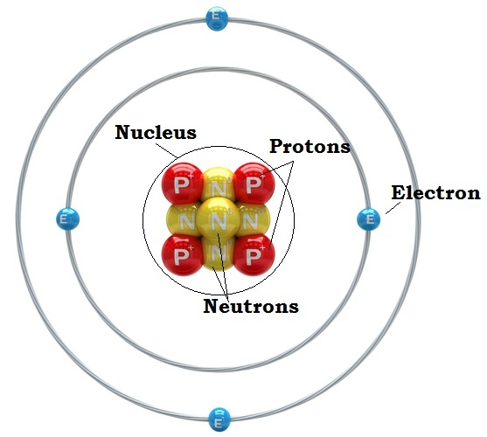
Nucleus & Orbitals
Protons and neutrons organized in the nucleus
Electrons spatially located outside of the nucleus
Electrons "orbit" the nucleus in orbitals but not like planets revolving around the sun
Their position/location is determined by probabilities calculated by complex mathematical expressions
Each orbital pairs two electrons of opposite spin
Yes, electrons have a spin just as the Earth rotates on an axis, and this spin generates a magnetic field

Slide 13
Atomic Mass Units (amu)
Definition of “amu” is 1/12th of mass of carbon-12 atom (has 6 protons, 6 neutrons, 6 electrons)
This is not equal to mass of one proton, which is actually equal to 1.007276 amu
This is only of importance to physicists and is explained by the “mass deficit” which is the energy to that holds a nucleus together

Slide 14
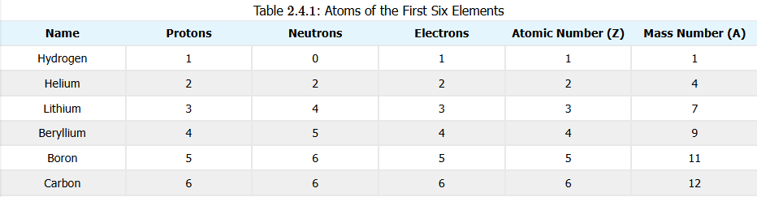
Atomic Properties
Atomic Number (the Z value)
essentially defines the element
makes hydrogen, oxygen, carbon, chlorine, etc. what it is
= number of protons (in atom’s nucleus)
Mass Number (the A value)
= sum of count of protons and neutrons in atom’s nucleus
Indicate the isotope form of element’s atoms

Slide 15
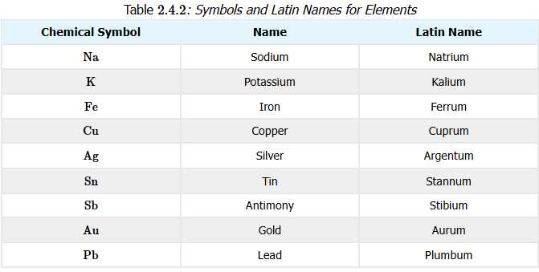
Atomic Properties
Names and Symbols
Elements have names and 1- or 2-character symbols that represent the element
Atoms are the physical part of the element
Learn the names and symbols of common elements

Slide 16
Isotopes
Elements can have different mass number (A) values. Chemistry is same though.
Hydrogen = 1 proton (99.9885%)
Deuterium (“hydrogen-2”) = 1 proton + 1 neutron (0.0115%)
Tritium (“hydrogen-3”) = 1 proton + 2 neutrons (1 in 10¹⁸)
radioactive (beta emitter)
Carbon-12 = 6 protons + 6 neutrons (98.93%)
Carbon-13 = 6 protons + 7 neutrons (1.07%)
Carbon-14 = 6 protons + 8 neutrons (trace)
Isotopic abundance values in parentheses

Slide 17
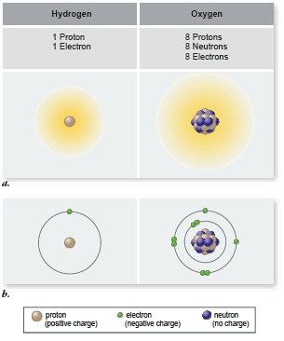
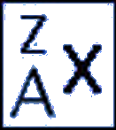
Elements
Elements all have the same number of protons
But elements can have different number of neutrons
An element with different numbers of neutrons is an isotope of the element
When referring to an isotope of an element, use this
Where
× is element symbol (e.g, hydrogen = H)
A is atomic number, = # protons (A = 1 for H)
Z is mass number, = #protons + #neutrons

Slide 18
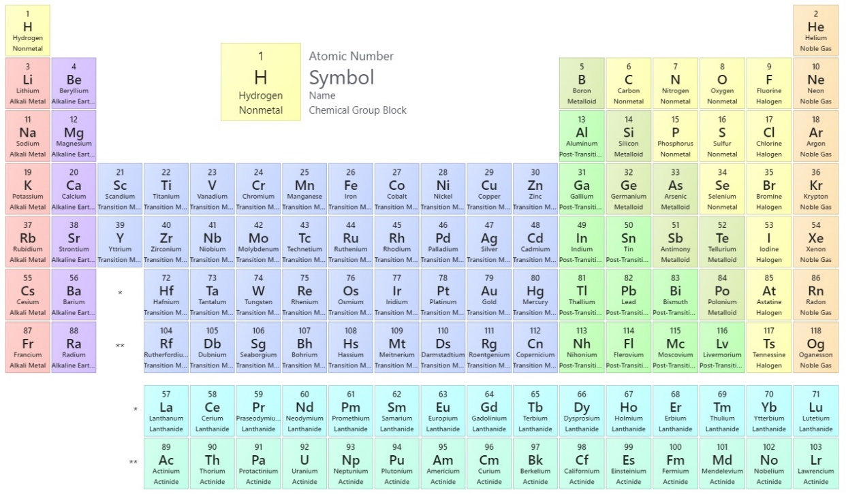
Patterns of Matter: Periodic Table
Observations
chlorine, bromine, iodine react with sodium
lithium, sodium, potassium react with other elements in similar ways
Organizing elements with these properties by Mendeleev (also Meyer)
Symbols
Element name (optional)
Atomic Number
Atomic Weight
Not the mass number!
The modern Periodic Table
https://chem.libretexts.org/Ancillary_Materials/Reference/Periodic_Table_of_the_Elements

Slide 19
Features of Periodic Table
Periods
The rows of the table
Number of elements in period not always same!
Pattern: 2, 8, 8, 18, 18, 32, 32 for the seven periods
Physical reason for this important in chemistry
Special periods: inner transition metals, lanthanides, actinides
Groups (“Families”)
The columns of the table
Usually have similar chemistry (chemical properties)

Slide 20
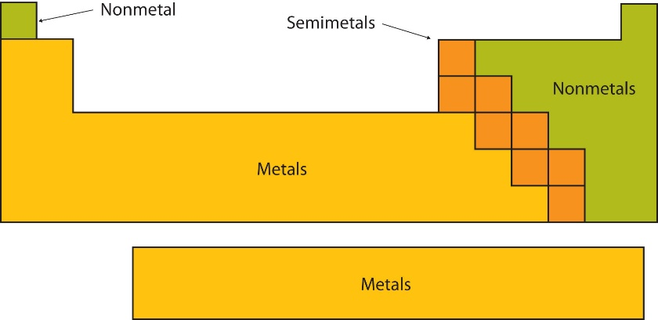
Patterns of Matter: Periodic Table
Classes of elements
Metals
“shiny”, “silvery in color” (but varies)
usually electrical and heat conductors
malleable (hammer into sheets)
ductile (pulled into wires)
Nonmetals
not shiny, brittle in solid form
poor electrical and heat conductors
“Metalloids” (Semimetals)
between metal and nonmetal: B, Si, Ge, As, Sb, Te
metallic luster, solid at room temperature
brittle (not malleable)
semiconductors: useful when “doped” with impurities
3/4ths of elements are metals

Slide 21
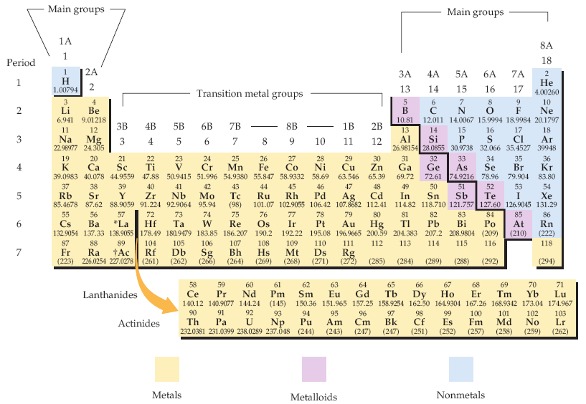
Periodic Table of Elements
Biologists should know what elements are (1) metals and (2) nonmetals generally
The periodic table of the elements. Each element is identified by a one- or two-letter symbol and is characterized by an atomic number. The table begins with hydrogen (H, atomic number 1) in the upper left-hand corner and continues to the yet unnamed element with atomic number 118. The 14 elements following lanthanum (La, atomic number 57) and the 14 elements following actinium (Ac, atomic number 89) are pulled out and shown below the others.
Elements are organized into 18 vertical columns, or groups, and 7 horizontal rows, or periods. The two groups on the left and the six on the right are the main groups; the ten in the middle are the transition metal groups. The 14 elements following lanthanum are the lanthanides, and the 14 elements following actinium are the actinides; together these are known as the inner transition metals. Two systems for numbering the groups are explained in the text. Those elements (except hydrogen) on the left-hand side of the zigzag line running from boron (B) to astatine (At) are metals, those elements to the right of the line are nonmetals, and most elements abutting the line are metalloids.
McMurry et al, Fundamentals of General, Organic and Biological Chemistry, 6 Ed, p 58

Slide 22
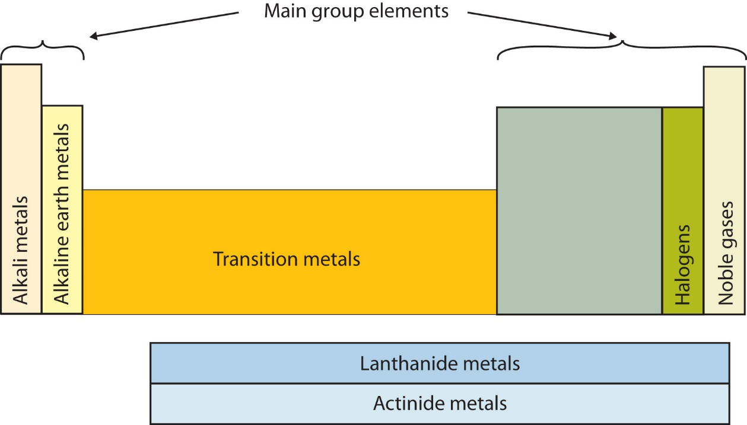
Special Groups of Elements
Some groups of elements should be noted since their chemistry is commonly observed

Slide 23
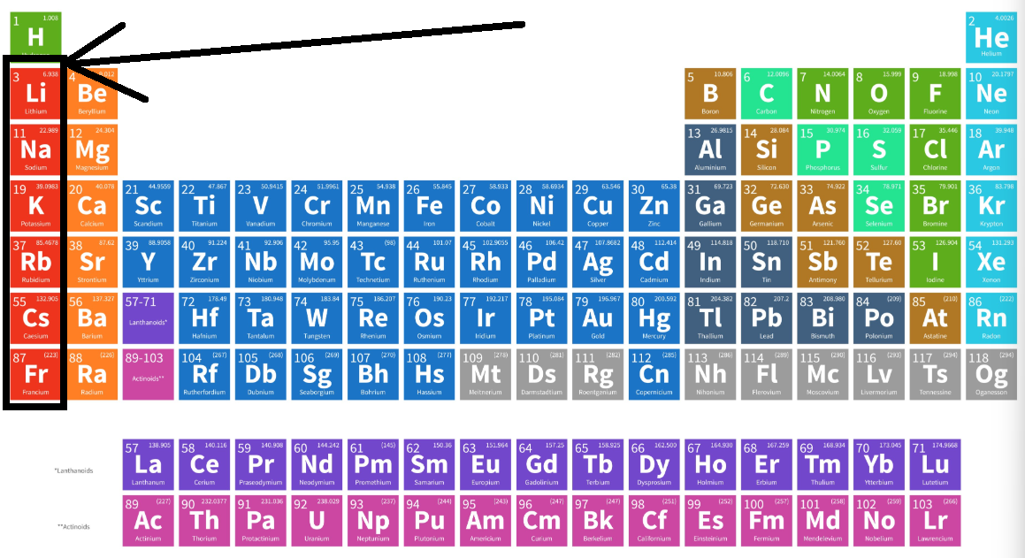
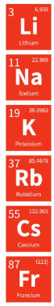
Special Groups of Elements
Alkali Metals Sodium:
table salt
cellular function
Potassium:
cellular function (like sodium)
Lithium:
used in “grease” lubricants
batteries
drugs to control neurological conditions affecting behavior (bipolar “disorder”)

Slide 24
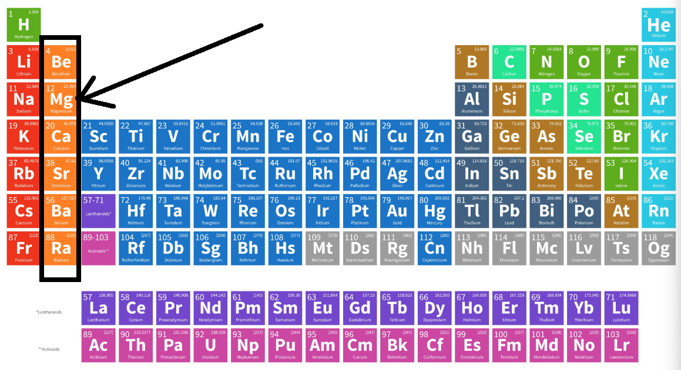
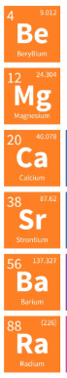
Special Groups of Elements
Alkaline Earth Metals
Magnesium:
also important in cellular function
Forms important minerals
Calcium:
Like magnesium, necessary for cell/tissue function
Limestone is calcium carbonate
Others are rare and Ra is radioactive

Slide 25
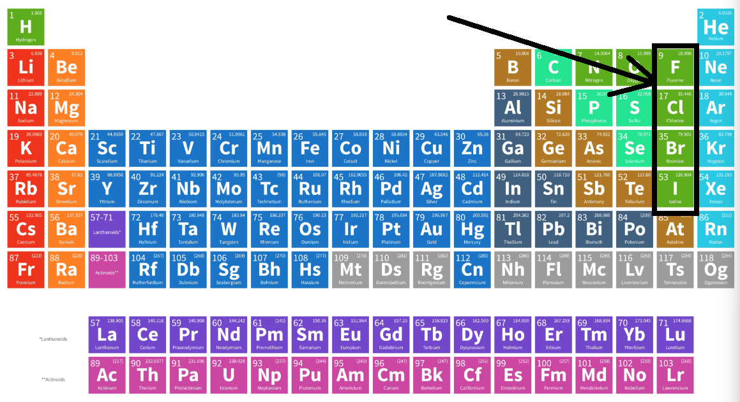
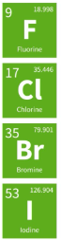
Special Groups of Elements
Halogens
Term “halogen” → salt-forming
React with metals to form salts
Fluorine:
the fluoride in toothpaste
non-stick Teflon
Chlorine:
essential for cellular function
a component of plastics (chlorides of carbon polymers)

Slide 26
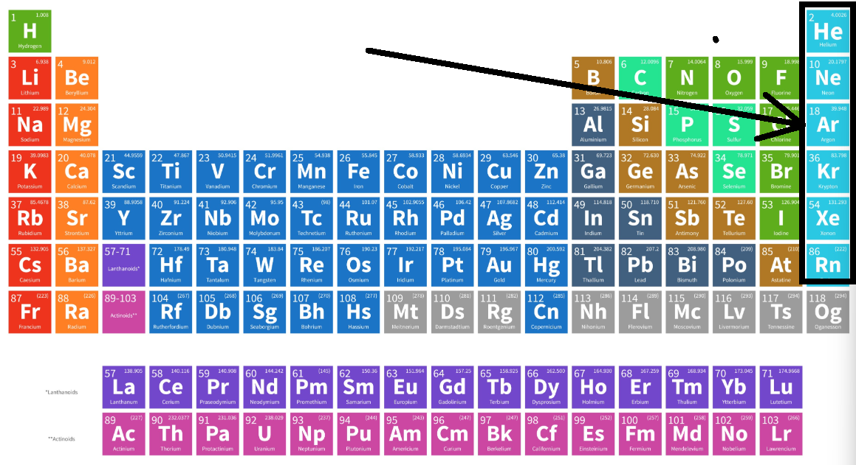
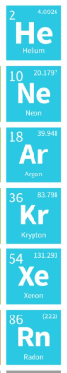
Special Groups of Elements
Noble Gases
Also called “inert gases” and “rare gases”
Basically once thought to be chemically unreactive
Usually exist as single atoms, explains why gases Neon used to make red lighting
But some form interesting compounds with nonmetals
Xenon hexafluoroplatinate (XePtF₆): first compound with noble gas ever produced
Xenon difluoride (XeF₂): powerful fluorinating and oxidizing agent used in microprocessor production
Krypton difluoride (KrF₂): used to make KrF excimer lasers for photolithography (ArF also used in this way)

Slide 27
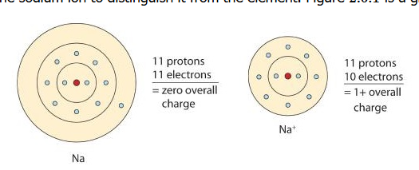
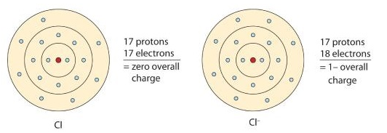
Electric properties of atoms: Ions
Ions
Neutral atom/particle: zero charge, plus=minus
Ions: positively or negatively charged atoms/particles
Cations – is a POSITIVELY charged ion
Lose an electron
Na ➔ Na⁺ + e⁻
Anions – is a NEGATIVELY charged ion
Gain an electron
e⁻ + Cl ➔ Cl⁻

Slide 28
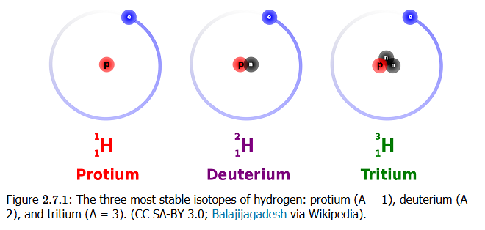
Isotopes
Isotopes are forms of an atom with the same proton number (Z) but different mass number (A)
That is, they are forms of an element with different numbers of neutrons in the atom

Slide 29
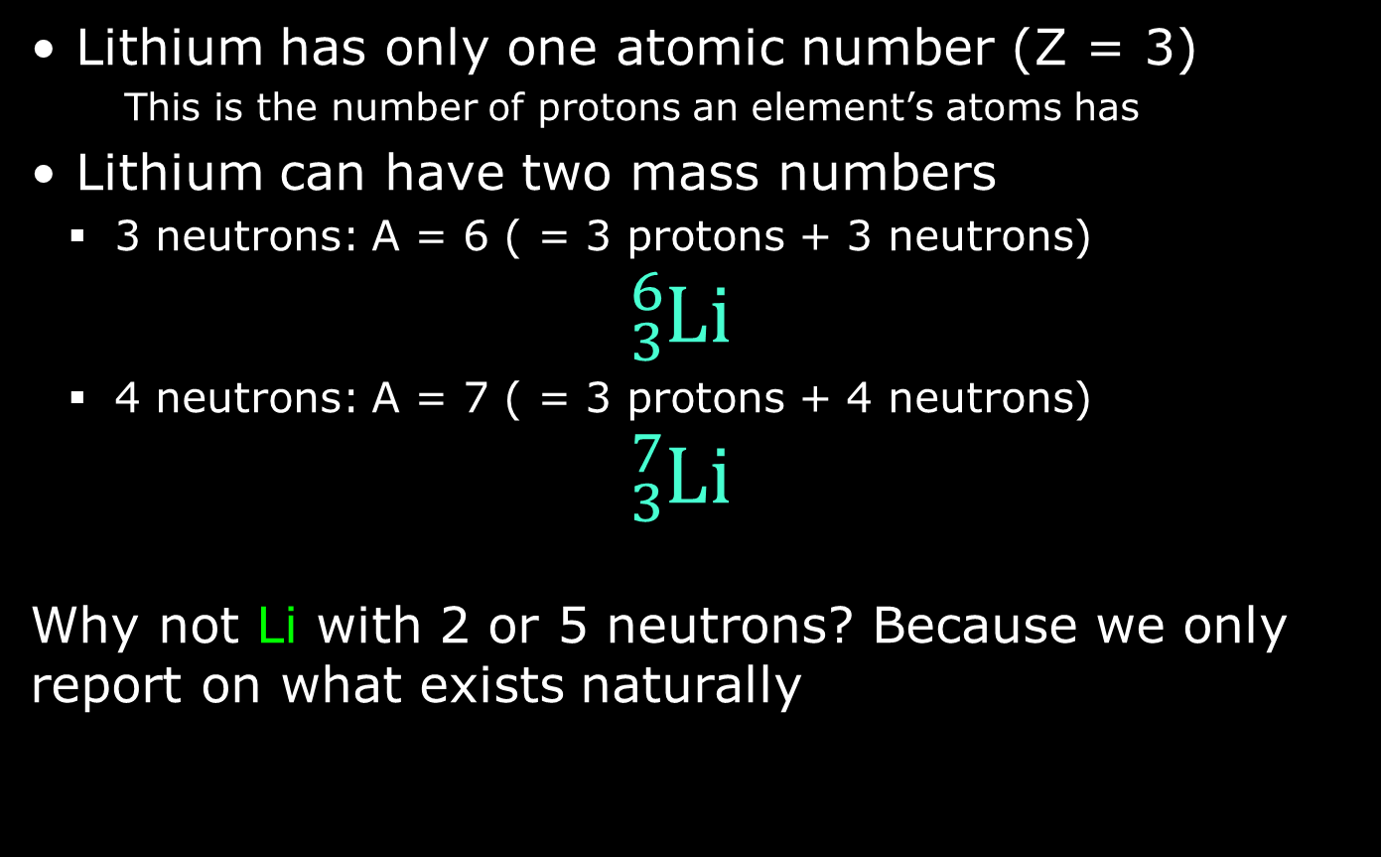
Isotopes
Lithium has only one atomic number (Z = 3)
This is the number of protons an element’s atoms has
Lithium can have two mass numbers
3 neutrons: A = 6 ( = 3 protons + 3 neutrons)
$${}_{3}^{6}{\text{Li}}$$
4 neutrons: A = 7 ( = 3 protons + 4 neutrons)
$${}_{3}^{7}{\text{Li}}$$
Why not Li with 2 or 5 neutrons? Because we only report on what exists naturally

Slide 30
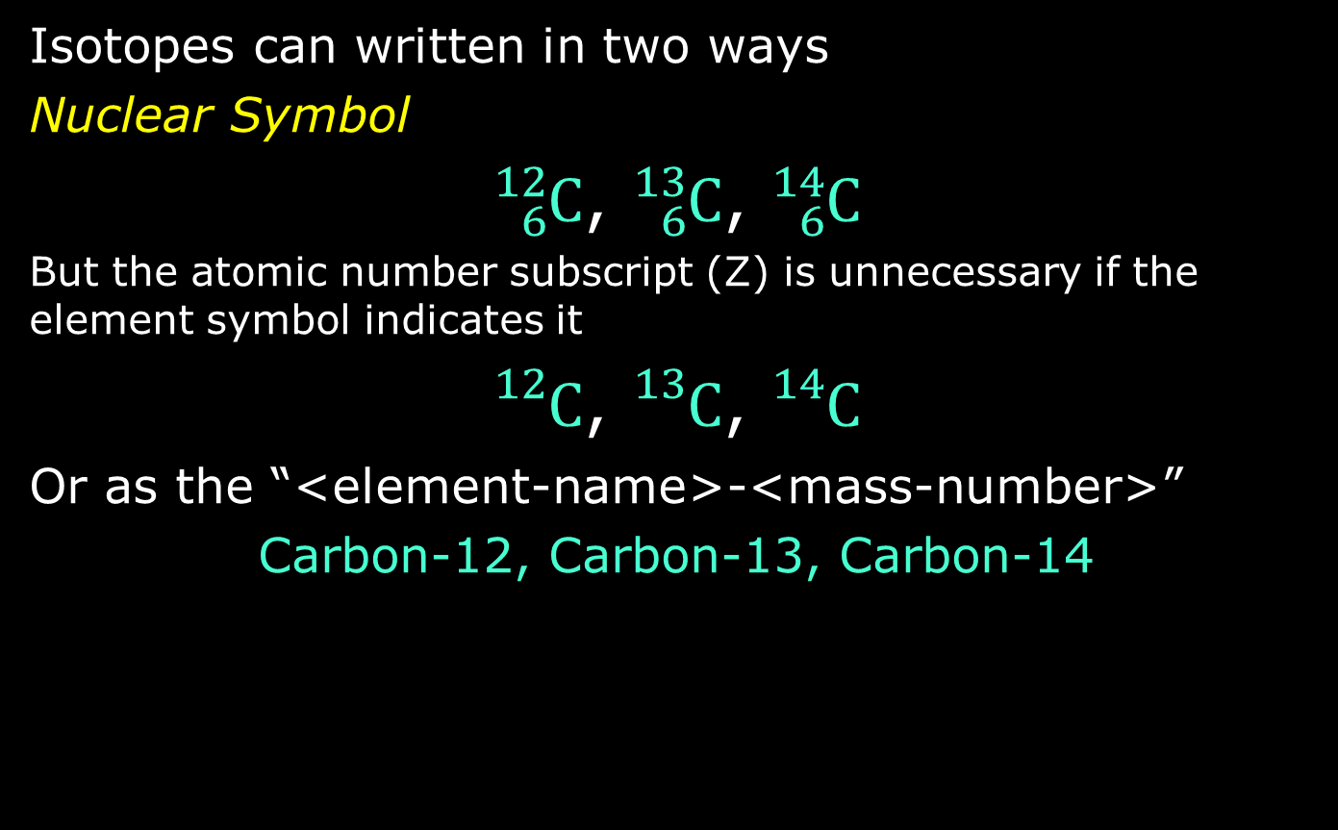
Representing Isotopes
Isotopes can written in two ways
Nuclear Symbol
${}_{6}^{12}{\text{C}}$, ${}_{6}^{13}{\text{C}}$, ${}_{6}^{14}{\text{C}}$
But the atomic number subscript (Z) is unnecessary if the element symbol indicates it
${}_{}^{12}{\text{C}}$, ${}_{}^{13}{\text{C}}$, ${}_{}^{14}{\text{C}}$
Or as the “<element-name>-<mass-number>”
Carbon-12, Carbon-13, Carbon-14

Slide 31
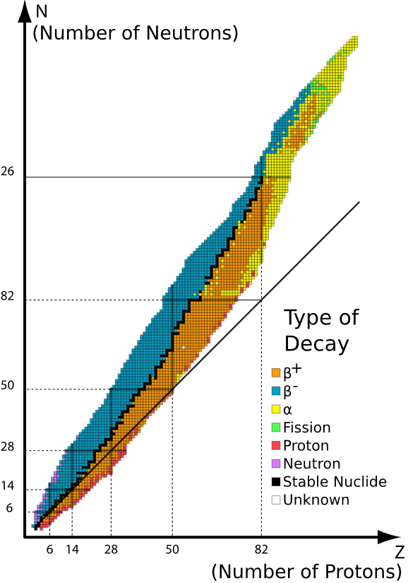
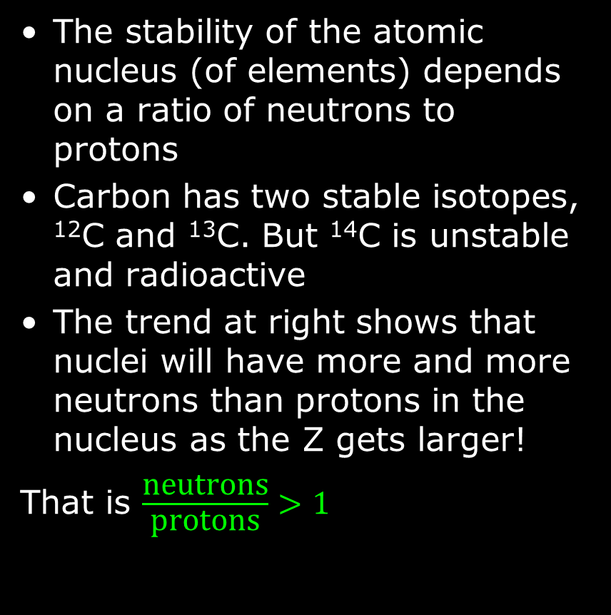
Isotope Stability
The stability of the atomic nucleus (of elements) depends on a ratio of neutrons to protons
Carbon has two stable isotopes, ¹²C and ¹³C. But ¹⁴C is unstable and radioactive
The trend at right shows that nuclei will have more and more neutrons than protons in the nucleus as the Z gets larger!
That is $\frac{\text{neutrons}}{\text{protons}}>1$

Slide 32
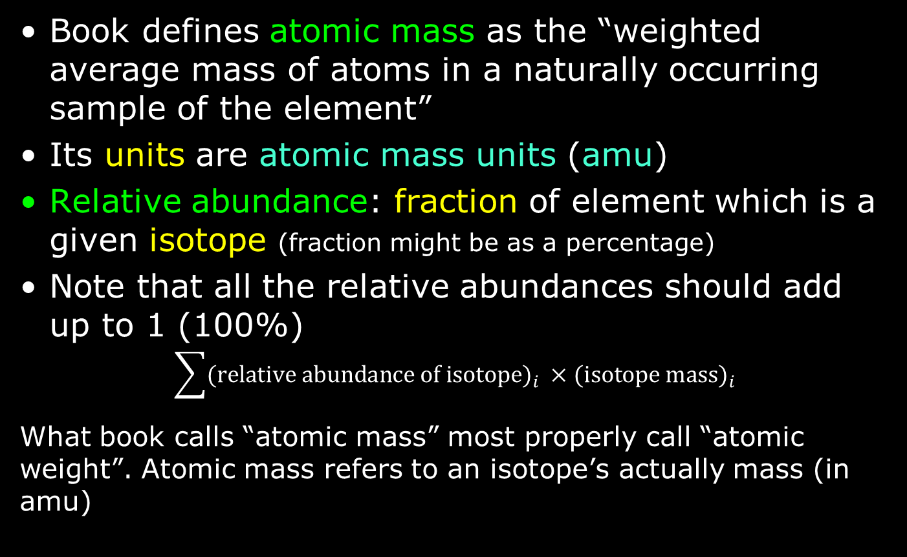
Atomic Mass (Atomic Weight)
Book defines atomic mass as the “weighted average mass of atoms in a naturally occurring sample of the element”
Its units are atomic mass units (amu)
Relative abundance: fraction of element which is a given isotope (fraction might be as a percentage)
Note that all the relative abundances should add up to 1 (100%)
$$\sum{{\text{(}\text{relative} \text{abundance} \text{of} \text{isotope}\text{)}}_{i} ×{\text{(}\text{isotope} \text{mass}\text{)}}_{i}}$$
What book calls “atomic mass” most properly call “atomic weight”. Atomic mass refers to an isotope’s actually mass (in amu)

Slide 33
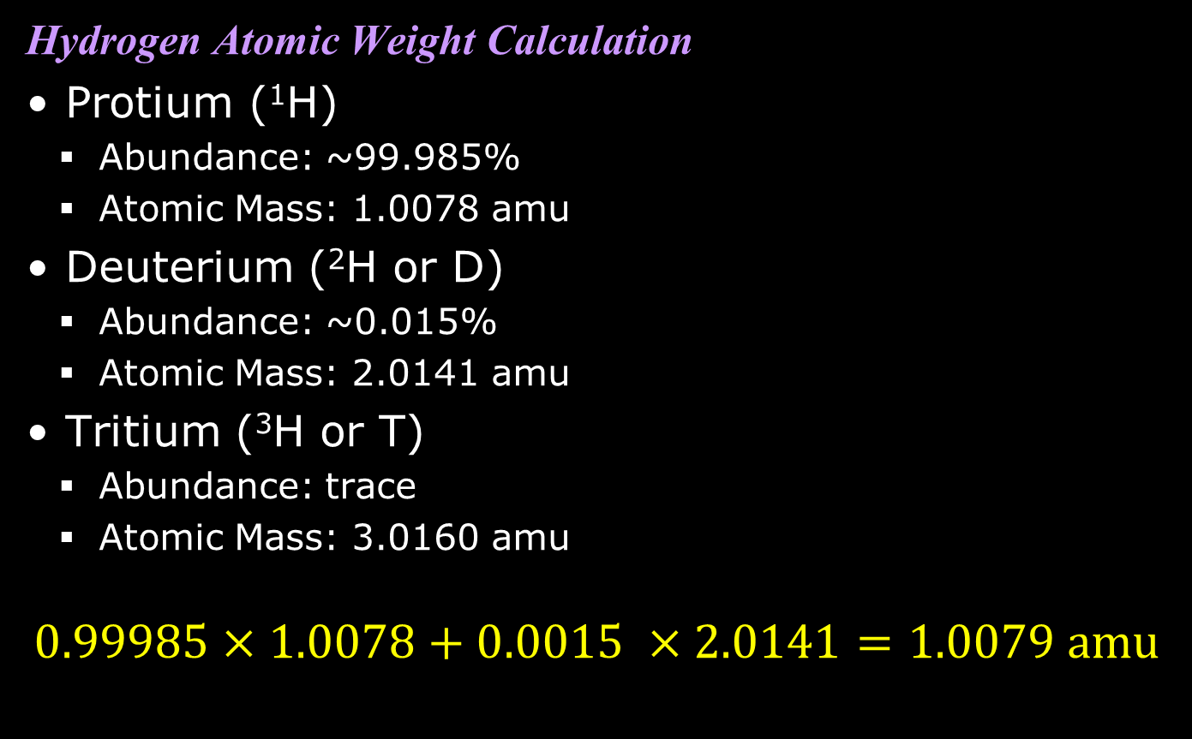
Atomic Weight Calculation
Hydrogen Atomic Weight Calculation
Protium (¹H)
Abundance: ~99.985%
Atomic Mass: 1.0078 amu
Deuterium (²H or D)
Abundance: ~0.015%
Atomic Mass: 2.0141 amu
Tritium (³H or T)
Abundance: trace
Atomic Mass: 3.0160 amu
$$0.99985×1.0078+0.0015 ×2.0141=1.0079 \text{amu}$$

Slide 34
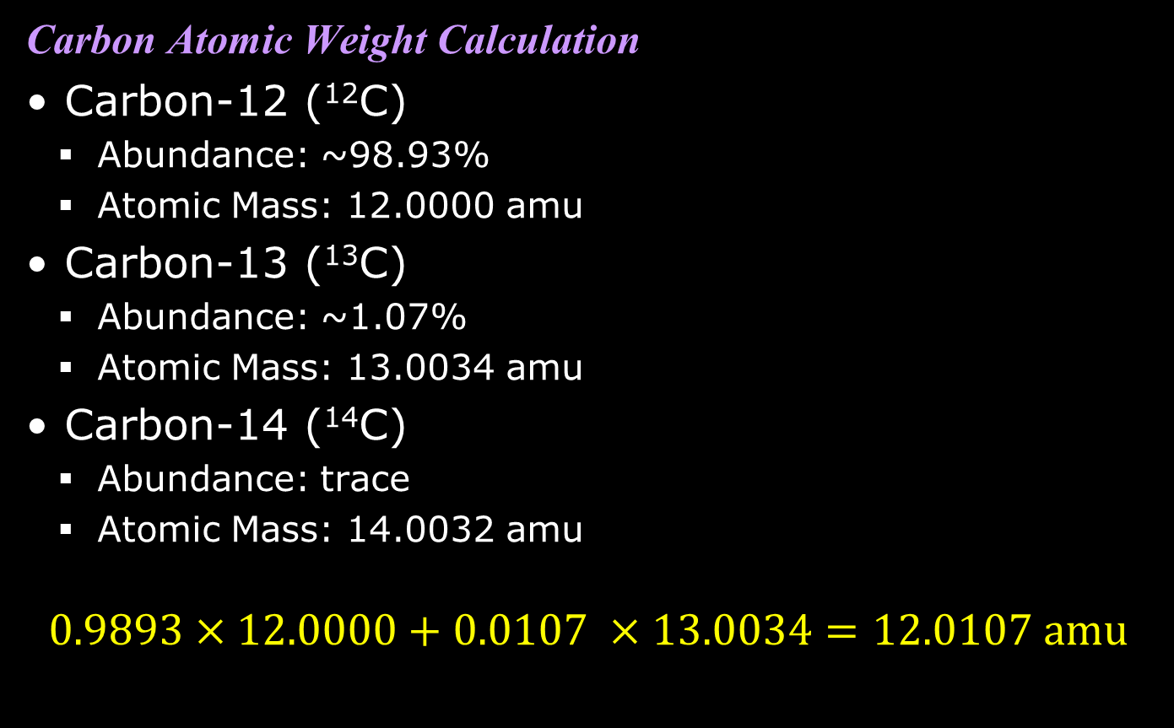
Atomic Weight Calculation
Carbon Atomic Weight Calculation
Carbon-12 (¹²C)
Abundance: ~98.93%
Atomic Mass: 12.0000 amu
Carbon-13 (¹³C)
Abundance: ~1.07%
Atomic Mass: 13.0034 amu
Carbon-14 (¹⁴C)
Abundance: trace
Atomic Mass: 14.0032 amu
$$0.9893×12.0000+0.0107 ×13.0034=12.0107 \text{amu}$$

Slide 35
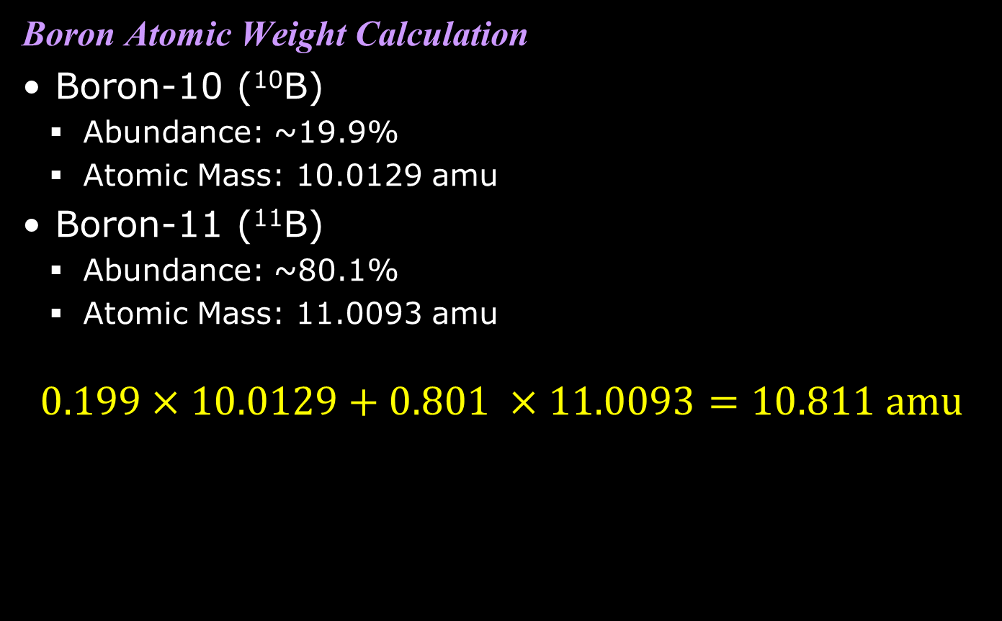
Atomic Weight Calculation
Boron Atomic Weight Calculation
Boron-10 (¹⁰B)
Abundance: ~19.9%
Atomic Mass: 10.0129 amu
Boron-11 (¹¹B)
Abundance: ~80.1%
Atomic Mass: 11.0093 amu
$$0.199×10.0129+0.801 ×11.0093=10.811 \text{amu}$$

Slide 36
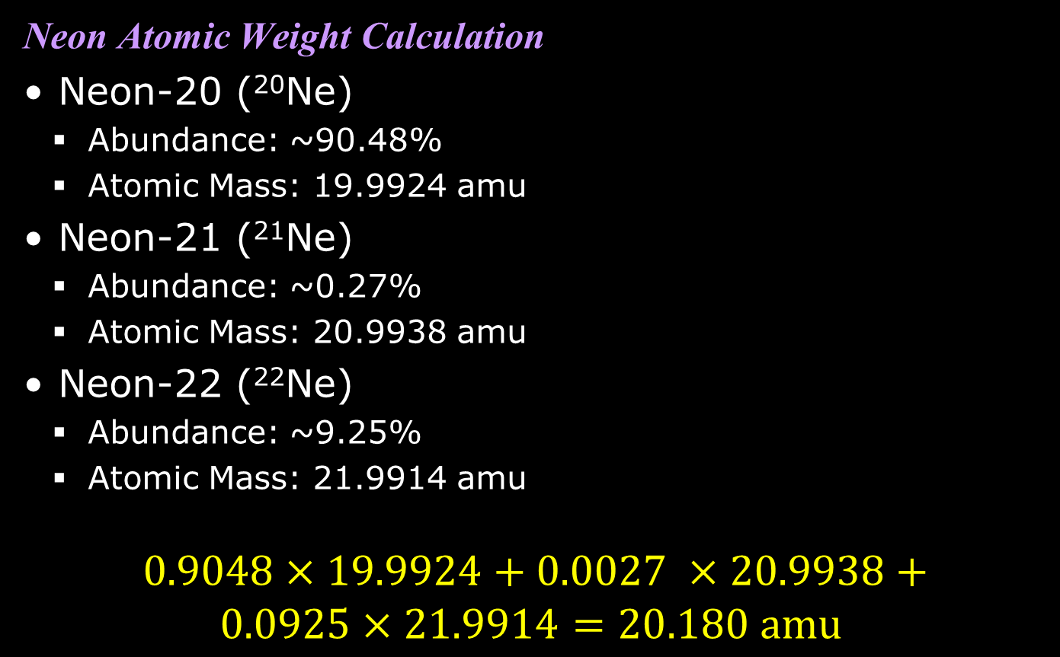
Atomic Weight Calculation
Neon Atomic Weight Calculation
Neon-20 (²⁰Ne)
Abundance: ~90.48%
Atomic Mass: 19.9924 amu
Neon-21 (²¹Ne)
Abundance: ~0.27%
Atomic Mass: 20.9938 amu
Neon-22 (²²Ne)
Abundance: ~9.25%
Atomic Mass: 21.9914 amu
$$0.9048×19.9924+0.0027 ×20.9938+ \\ 0.0925×21.9914=20.180 \text{amu}$$

